Slide 1
Systems Analysis and Design
Chapter 4-5-6-7
Part - 5
Chapter 7
Development Strategies

Slide 2
Chapter Objectives
Describe the concept of Software as a Service
Define Web 2.0 and cloud computing
Explain software acquisition alternatives, including traditional and Web-based software development strategies
Describe software outsourcing options, including offshore outsourcing and the role of service providers

Slide 3
Chapter Objectives
Explain advantages and disadvantages of in-house software development
Explain cost-benefit analysis and financial analysis tools
Explain the differences between a request for proposal (RFP) and a request for quotation (RFQ)
Describe the system requirements document

Slide 4
Chapter Objectives
Explain the transition from systems analysis to systems design, and the importance of prototyping
Discuss guidelines for systems design
Describe software development trends

Slide 5
Introduction
Chapter 7 describes the remaining activities in the systems analysis phase
The chapter also describes the transition to systems design, prototyping, and systems design guidelines
The chapter concludes with a discussion of trends in software development

Slide 6
Development Strategies Overview
Selecting the best development path is an important decision that requires companies to consider three key topics
The impact of the Internet
Software outsourcing options
In-house software development alternatives

Slide 7
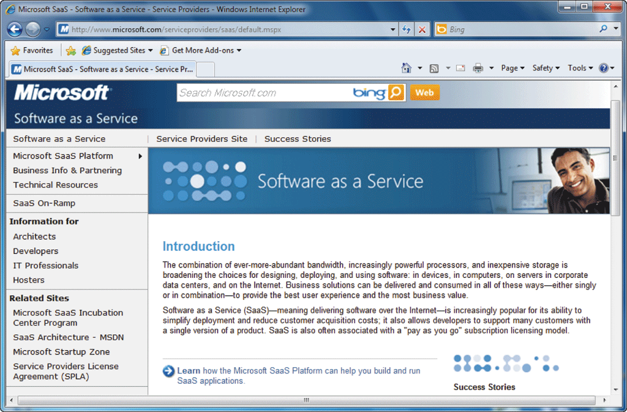
The Impact of the Internet
Software as a Service
Software as a Service (SaaS)
25% of all new business software will be deployed as a service by 2011, while the value of the SaaS industry will grow to $40 billion

Slide 8
The Impact of the Internet
Traditional vs. Web-Based Systems Development
Traditional development
System design is influenced by compatibility issues
Systems are designed to run on local and wide-area company networks
Systems often utilize Internet links and resources, but Web-based features are treated as enhancements rather than core elements of the design

Slide 9
The Impact of the Internet
Traditional vs. Web-Based Systems Development
Web-based development
Systems are developed and delivered in an Internet-based framework such as .NET or WebSphere
Although there is a major trend toward Web-based architecture, many firms rely on traditional systems

Slide 10
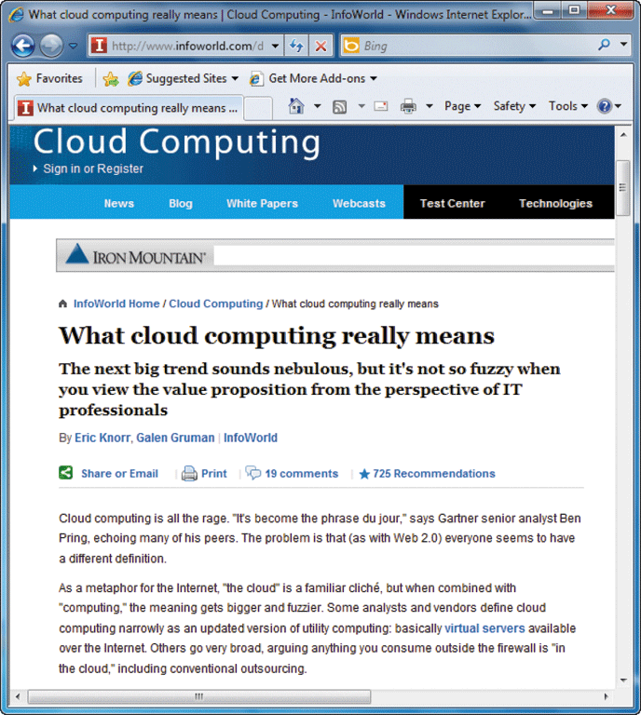
The Impact of the Internet
Looking to the Future: Web 2.0 and Cloud Computing
The Web 2.0 platform will enhance interactive experiences including wikis and blogs, and social networking applications
Cloud computing could bring enormous computing power to business and personal Internet users

Slide 11
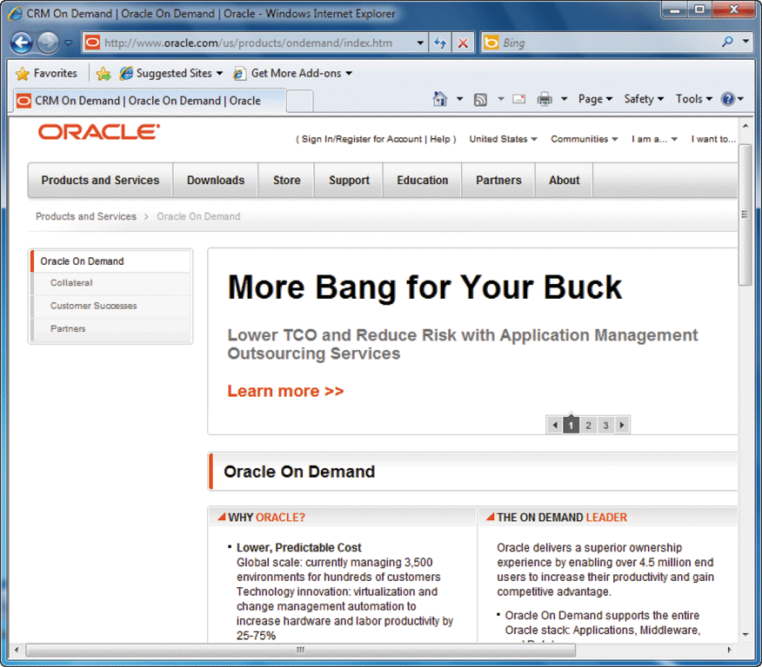
Outsourcing
The Growth of Outsourcing
A firm that offers outsourcing solutions is called a service provider
Application service providers (ASP)
Internet business services (IBS)
Also called managed hosting

Slide 12
Outsourcing
Outsourcing Fees
A fixed fee model uses a set fee based on a specified level of service and user support
A subscription model has a variable fee based on the number of users or workstations that have access to the application
A usage model or transaction model charges a variable fee based on the volume of transactions or operations performed by the application

Slide 13
Outsourcing
Outsourcing Issues and Concerns
Mission-critical IT systems should be outsourced only if the result is a cost-attractive, reliable, business solution that fits the company’s long-term business strategy
Outsourcing also can affect day-to-day company operations and can raise some concerns

Slide 14
Outsourcing
Offshore Outsourcing
Offshore outsourcing – global outsourcing
Many firms are sending IT work overseas at an increasing rate
The main reason for offshore outsourcing is the same as domestic outsourcing: lower bottom-line costs
Offshore outsourcing, however, involves some unique risks and concerns

Slide 15
In-House Software Development Options
Make or Buy Decision
The choice between developing versus purchasing software often is called a make or buy, or build or buy decision
The company’s IT department makes, builds, and develops in-house software
A software package is obtained from a vendor or application service provider.

Slide 16
In-House Software Development Options
Developing Software In-House
Satisfy unique business requirements
Minimize changes in business procedures and policies
Meet constraints of existing systems
Meet constraints of existing technology
Develop internal resources and capabilities

Slide 17
In-House Software Development Options
Purchasing a Software Package
Lower costs
Requires less time to implement
Proven reliability and performance benchmarks
Requires less technical development staff
Future upgrades provided by the vendor
Input from other companies

Slide 18
In-House Software Development Options
Customizing a Software Package
You can purchase a basic package that vendors will customize to suit your needs
You can negotiate directly with the software vendor to make enhancements to meet your needs by paying for the changes
You can purchase the package and make your own modifications, if this is permissible under the terms of the software license

Slide 19
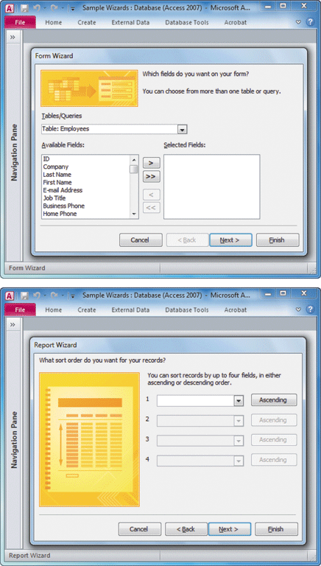
In-House Software Development Options
Creating User Applications
User application
User interface
Help desk or information center (IC)
Screen generators
Report generators
Read-only properties

Slide 20
Role of the Systems Analyst
When selecting hardware and software, systems analysts often work as an evaluation and selection team
The primary objective of the evaluation and selection team is to eliminate system alternatives that will not meet requirements, rank the system alternatives that are feasible, and present the viable alternatives to management for a final decision

Slide 21
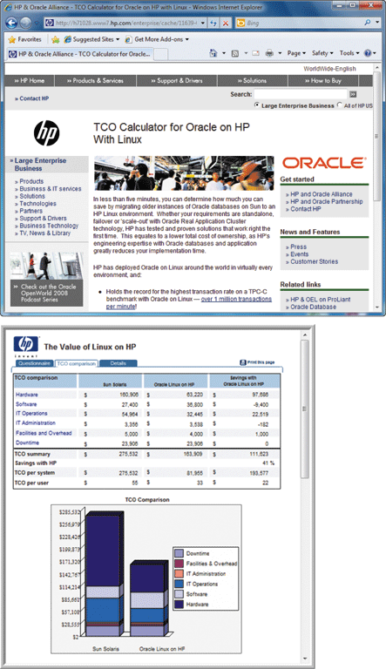
Analyzing Cost and Benefits
Financial Analysis Tools
Payback Analysis
Return on investment (ROI)
Net present value (NPV)

Slide 22
Analyzing Cost and Benefits
Cost-Benefit Analysis Checklist
List each development strategy being considered
Identify all costs and benefits for each alternative. Be sure to indicate when costs will be incurred and benefits realized
Consider future growth and the need for scalability
Include support costs for hardware and software

Slide 23
Analyzing Cost and Benefits
Cost-Benefit Analysis Checklist
Analyze various software licensing options, including fixed fees and formulas based on the number of users or transactions
Apply the financial analysis tools to each alternative
Study the results and prepare a report to management

Slide 24
The Software Acquisition Process
Step 1: Evaluate the Information System Requirements
Identify key features
Consider network and web-related issues
Estimate volume and future growth
Specify hardware, software, or personnel constraints
Prepare a request for proposal or quotation

Slide 25
The Software Acquisition Process
Step 2: Identify Potential Vendors or Outsourcing Options
The Internet is a primary marketplace
Another approach is to work with a consulting firm
Another valuable resource is the Internet bulletin board system that contains thousands of forums, called newsgroups

Slide 26
The Software Acquisition Process
Step 3: Evaluate the Alternatives
Existing users
Application testing
Benchmarking - benchmark
Match each package against the RFP features and rank the choices

Slide 27
The Software Acquisition Process
Step 4: Perform Cost-Benefit Analysis
Identify and calculate TCO for each option you are considering
When you purchase software, what you are buying is a software license
If you purchase a software package, consider a supplemental maintenance agreement

Slide 28
The Software Acquisition Process
Step 5: Prepare a Recommendation
You should prepare a recommendation that evaluates and describes the alternatives, together with the costs, benefits, advantages, and disadvantages of each option
At this point, you may be required to submit a formal system requirements document and deliver a presentation

Slide 29
The Software Acquisition Process
Step 6: Implement the Solution
Implementation tasks will depend on the solution selected
Before the new software becomes operational, you must complete all implementation steps, including loading, configuring, and testing the software; training users; and converting data files to the new system’s format

Slide 30
Completion of Systems Analysis Tasks
System Requirements Document
The system requirements document, or software requirements specification, contains the requirements for the new system, describes the alternatives that were considered, and makes a specific recommendation to management
Like a contract
Format and organize it so it is easy to read and use

Slide 31
Completion of Systems Analysis Tasks
Presentation to Management
Summarize the primary viable alternatives
Explain why the evaluation and selection team chose the recommended alternative
Allow time for discussion and for questions and answers
Obtain a final decision from management or agree on a timetable for the next step in the process

Slide 32
Completion of Systems Analysis Tasks
Presentation to Management
Depending on their decision, your next task as a systems analyst will be one of the following
Implement an outsourcing alternative
Develop an in-house system
Purchase or customize a software package
Perform additional systems analysis work
Stop all further work

Slide 33
The Transition to Systems Design
Preparing for Systems Design Tasks
It is essential to have an accurate and understandable system requirements document
Logical and Physical Design
The logical design defines the functions and features of the system and the relationships among its components
The physical design of an information system is a plan for the actual implementation of the system

Slide 34
Systems Design Guidelines
Overview
A system is effective if it supports business requirements and meets user needs
A system is reliable if it handles input errors, processing errors, hardware failures, or human mistakes
A system is maintainable if it is flexible, scalable, and easily modified

Slide 35
Systems Design Guidelines
Overview
User Considerations
Carefully consider any point where users receive output from, or provide input
Anticipate future needs - Y2K Issue
Provide flexibility
Parameter, default

Slide 36

Systems Design Guidelines
Overview
Data Considerations
Enter data as soon as possible
Verify data as it is entered
Use automated methods of data entry whenever possible

Slide 37
Systems Design Guidelines
Overview
Data Considerations
Control data entry access and report all entries or changes to critical values – audit trail
Log every instance of data entry and changes
Enter data once
Avoid data duplication

Slide 38
Systems Design Guidelines
Overview
Architecture considerations
Use a modular design
Design modules that perform a single function are easier to understand, implement, and maintain

Slide 39
Systems Design Guidelines
Design Trade-Offs
Design goals often conflict with each other
Most design trade-off decisions that you will face come down to the basic conflict of quality versus cost
Avoid decisions that achieve short-term savings but might mean higher costs later

Slide 40
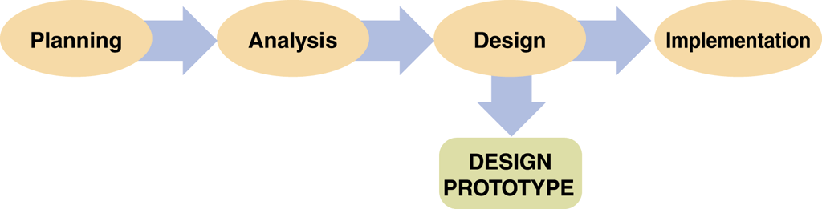
Prototyping
Prototyping Methods
System prototyping
Design prototyping
Throwaway prototyping
Prototyping offers many benefits
Consider potential problems

Slide 41
Prototyping
Prototyping Tools
CASE tools
Application generators
Report generators
Screen generators
Fourth-generation language (4GL)
Fourth-generation environment

Slide 42
Prototyping
Limitations of Prototypes
A prototype is a functioning system, but it is less efficient than a fully developed system
Systems developers can upgrade the prototype into the final information system by adding the necessary capability
Otherwise, the prototype is discarded

Slide 43
Software Development Trends
Views from the IT Community
Software quality will be more important than ever
Project management will be a major focus of IT managers

Slide 44
Software Development Trends
Views from the IT Community
Service-oriented architecture (SOA)
Loose coupling
Growth in open-source software
Developers will use more Web services
Programmers will continue to use dynamic languages

Slide 45
Chapter Summary
This chapter describes system development strategies, the preparation and presentation of the system requirements document, and the transition to the systems design phase of the SDLC
An important trend that views software as a service, rather than a product, has created new software acquisition options
Systems analysts must consider Web-based development environments

Slide 46
Chapter Summary
The systems analyst’s role in the software development process depends on the specific development strategy
The most important factor in choosing a development strategy is total cost of ownership (TCO)
The process of acquiring software involves a series of steps
A prototype is a working model of the proposed system

Slide 47
Chapter Summary
Chapter 7 complete

